Slide 1
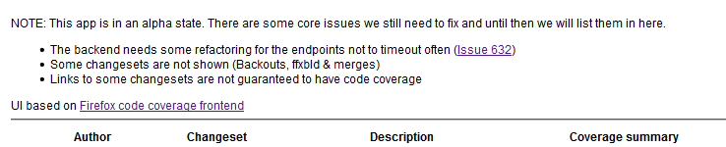
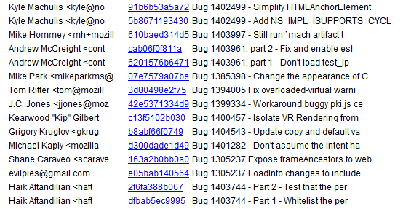
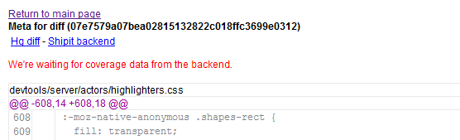
1. Click on a changeset
2. If coverage is not available, wait, then reload

Slide 2
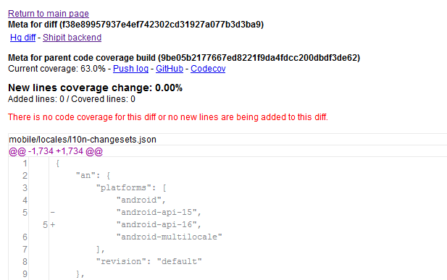
3. Some changesets have no runnable lines

Slide 3
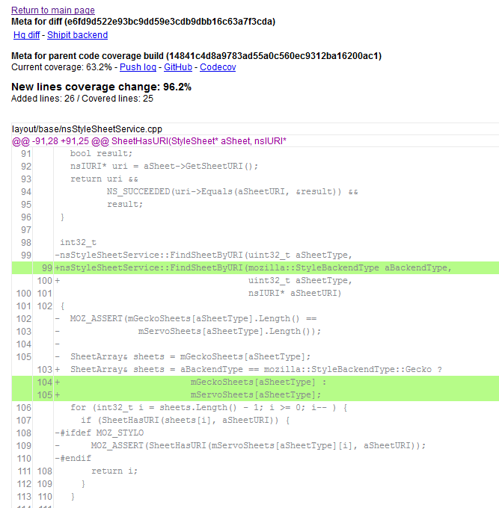
4. When there is coverage, we highlight the new (runnable) lines covered

Slide 4
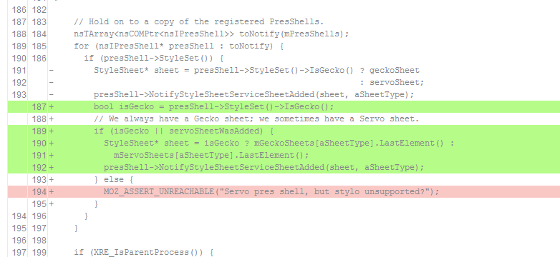
5. …and highlight (runnable) lines NOT covered

